Slide 1
NOT FOR FURTHER DISTRIBUTION
Real estate tax strategies
1031s | DSTs | 721s | Opportunity Zones
The information contained herein is for informational purposes only and is not an offer or a solicitation related to the sale of any securities. Such an offer or solicitation can be made only through an offering memorandum and no information herein would be a part thereof. The analysis contained herein does not constitute an investment recommendation or take into account the particular investment objectives, investment strategies, financial situation and needs of any specific recipient. We recommend that you obtain financial , legal, accounting, and/or tax advice as to the implications of investing in the manner described herein. Certain services and products are subject to legal restrictions and cannot be offered worldwide on an unrestricted basis and/or may not be eligible for sale to all investors. All information and opinions expressed in this document were obtained from sources believed to be reliable and in good faith, but no representation or warranty, express or implied, is made as to its accuracy or completeness. All information and opinions as well as any prices indicated are current only as of the date of this report and are subject to change without notice. Opinions expressed herein may differ or be contrary to those expressed by other business areas or divisions of Cantor Fitzgerald, L.P. (“Cantor Fitzgerald”) or its affiliates as a result of using different assumptions and/or criteria. The contents of this document have not been and will not be approved by any securities or investment authority in the United States or elsewhere. Cantor Fitzgerald and its affiliates disclaim any and all liability for any loss that may arise from use of the information contained herein.
References herein to past returns of any fund, investment product or market sector are not an indication of future performance. Cantor Fitzgerald and its affiliates specifically prohibit the redistribution or reproduction of this material in whole or in part without the prior written permission of Cantor Fitzgerald. Cantor Fitzgerald accepts no liability whatsoever for the actions of third parties in this respect.
Cantor Fitzgerald and its affiliates do not provide tax, legal, or accounting advice. This material and any accompanying communications have been prepared for informational purposes only, and do not constitute, are not intended to provide and should not be relied on as an investment recommendation or tax, legal, accounting, financial or other advice by Cantor Fitzgerald or its affiliates. You should consult your own tax, legal, and accounting, financial or other professionals before engaging in any transaction.

Slide 2
Risk Factors – 1031s, DSTs and 721s
There is no guarantee of success. Investors could incur a loss of all or a portion of any investment.
No public market exists for Delaware Statutory Trust (“DST”) interests, and it is highly unlikely that any such market will develop.
There are typically substantial restrictions on the transfer of DST interests.
There is typically no specified time that properties owned by s DST will be liquidated and the DST may not be able to sell any or all of the properties at a price sufficient to return to investors an amount greater than the purchase price paid by investors for the DST interests.
DSTs are a relatively new vehicle for real estate investment and are inflexible vehicles to own real property.
If a property is transferred (or a DST is converted) to a “springing LLC”, investors will likely lose their ability to participate in a future Code Section 1031 Exchange with respect to the transferred property (or interests in the springing LLC that investors in a DST will receive upon any conversion of the DST to a springing LLC). Investors will also lose their ability to participate in a future Code Section 1031 Exchange with respect to any DST interests contributed to an UPREIT (as defined herein) in exchange for partnership units in such UPREIT.
Investors typically have no voting rights and will have no control over management of a DST or its properties.
In a two-step transaction, there is no guarantee that an investor will be able to exchange its DST interests for partnership units in an UPREIT.
As a partner in a partnership, a holder of operating partnership units may be allocated taxable income in excess of cash distributions it receives. Such holder may need to find alternative sources of cash to pay the tax liability on its allocated income.
The Section 1031 Exchange rules are complex and a variety of factors could cause acquisitions of DST interests to fail to qualify as Section 1031 Exchanges. In addition, a portion of the proceeds from an investor’s sale of his, her or its relinquished property could constitute taxable “boot”.
In the event the operating partnership of an UPREIT sells the property contributed by an investor pursuant to a 721 exchange, any “built-in gain” recognized upon such sale will be entirely allocated to the contributing investor. Such investor may have only limited rights to prevent or delay such a sale in accordance with a “tax protection agreement”.
The qualification requirements for a REIT are complex. There is no guarantee that, after a 721 exchange, the REIT will continue to qualify as a REIT, which could adversely affect its operations and its ability to make distributions.
Future legislative or regulatory action could significantly and/or adversely change the tax aspects of an investment in a DST interest, the availability of Section 1031 Exchanges and other tax aspects summarized herein.

Slide 3
Risk Factors – Opportunity Zones
The Qualified Opportunity Zone rules are new and the U.S. Department of Treasury and the Internal Revenue Service have issued regulations (together with the Qualified Opportunity Zone rules, the "QOZ Program"), but many questions remain unanswered and changes to the QOZ Program could potentially reverse the tax benefits provided thereunder (the "QOZ Tax Benefits"). In addition, there is a lack of precedent and limited guidance with respect to the QOZ Program.
Investors in Qualified Opportunity Funds will need to hold their investments for certain time periods in order to receive the full QOZ Tax Benefits afforded by the QOZ Program. A failure to do so may result in the potential tax benefits to the investor being reduced or eliminated.
Qualified Opportunity Funds organized as partnerships (or limited liability companies treated as partnerships) for federal income tax purposes are subject to complex tax rules. Investors should consults with their own tax advisors with respect to these rules and their impact on an investment.
If a fund fails to meet any of the qualification requirements to be considered a Qualified Opportunity Funds, the anticipated QOZ Tax Benefits may be reduced or eliminated and, in addition, the fund may be subject to certain penalties. Furthermore, a fund may fail to qualify as a Qualified Opportunity Funds for non-tax reasons beyond its control, such as financing issues, zoning issues, disputes with co-investors, etc.
Distributions to investors in a Qualified Opportunity Funds may result in a taxable gain to such investors. Moreover, because investors will be allocated their share of a fund’s income, gains, losses and deductions, if such fund is a partnership for federal income tax purposes, an investor may be liable for federal income taxes a result of its ownership of an interest in the fund, even if the fund does not make a distribution to investors.
The tax treatment of distributions to holders of interests in a Qualified Opportunity Fund may be uncertain, including whether distributions impact the aforementioned QOZ Program Tax Benefits.
A Qualified Opportunity Fund must make investments in Qualified Opportunity Zones, which carries the inherent risk associated with investing in economically depressed areas.
Any additional legislation or administrative guidance may reduce or eliminate the expected potential QOZ Tax Benefits or increase the burden of compliance with the QOZ Program.
Investors in a Qualified Opportunity Fund may not be able to take advantage of the QOZ Program’s tax benefits if they do not properly make a deferral election on IRS Form 8949.
Qualified Opportunity Funds may encounter significant opposition from local communities, political groups or unions, which may damage their goodwill and reputation and adversely affect operations.
An investment in a Qualified Opportunity Fund is likely speculative, illiquid and involves a high degree of risk. This is no guarantee that investors will receive any return.
The state, local and other tax implications of a Qualified Opportunity Zone investment may not be clear and Investors may not qualify for QOZ Program Tax Benefits at the state or local level.

Slide 4
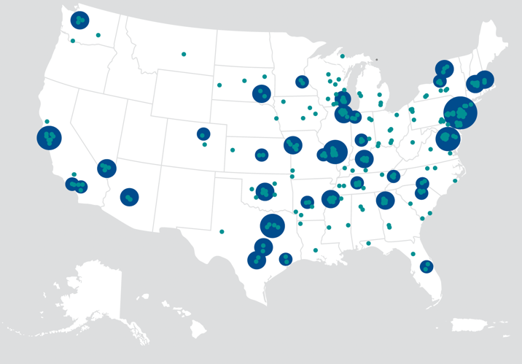
NATIONAL REAL ESTATE REACH
A HISTORY SPANNING 75 YEARS
Real-time access to vast commercial real estate data helps to position Cantor Fitzgerald at the nexus of every phase of a transaction — from buying and selling to financing some of the world’s leading properties.
Founded in 1945, Cantor Fitzgerald is a global financial services firm with significant real estate, capital markets, research and investment expertise
OVER $200 BILLION
in real estate-related transactions¹ since 2019
GLOBAL FOOTPRINT
More than 160 offices in 22 countries
REAL ESTATE EXPERTISE
Through a powerful alignment of vertically integrated affiliates, Cantor Fitzgerald’s real estate platform offers broad access to critical market data and research, enhanced ability for diligence and underwriting, and superior deal flow enabling the ability to deliver institutional-quality alternative investments to investors.
EXPANSIVE TEAM
Across all platforms, Cantor Fitzgerald has more than 12,000 employees worldwide
INVESTMENT GRADE
Maintains an investment-grade credit rating by Standard & Poor’s and Fitch
Primary Dealer
One of the 24 primary dealers authorized to transact business with the Federal Reserve Bank of New York
¹ Includes originated debt and non-originated debt placement transactions.
Cantor Fitzgerald refers to Cantor Fitzgerald, L.P., its subsidiaries, including Cantor Fitzgerald & Co., and its affiliates including BGC Partners (NASDAQ: BGCP) and Newmark (NASDAQ:NMRK).

Slide 5
Diversified Solution Set
CORE REAL ESTATE
1031s/DSTs/721s
Cantor Fitzgerald INCOME TRUST, INC.
Cantor Fitzgerald PRIVATE PLACEMENT PROGRAMS
INVESTOR
opportunity zone PLATFORM
Cantor Fitzgerald insured cash PROGRAM
OPPORTUNITY ZONES
CASH MANAGEMENT
Available for electronic subscription via Altigo

Slide 6
1031s, DSTs, and 721 EXCHANGES
^{Overview}

Slide 7
IRC Section 1031
IRC SECTION 1031 STATES
1031 EXCHANGE RULES
7
“
No gain or loss shall be recognized on the exchange of real property held for productive use in a trade or business or for investment if such real property is exchanged solely for real property of LIKE-KIND* which is to be held either for productive use in a trade or business or for investment.
PURCHASE
VALUE
SOLD
VALUE
>
INVESTED EQUITY
_
EQUITY AMOUNT
FROM SALE
“
DEBT ON REPLACEMENT PROPERTY
DEBT ON RELINQUISHED PROPERTY
*Like-kind is a property similar in nature or character, regardless of differences in grade, property type, or quality.
Invested equity must be equal to or greater than the equity received from sale, and the total purchase of the replacement property must be equal to or greater than value of the property sold.
Day
Day
Day
1031 EXCHANGE TIMELINE
Sale of relinquished property
Identification period starts
Identification period ends
Last day to purchase
replacement property

Slide 8
Delaware Statutory Trusts (“DSTs”)
A business trust that can be used for real estate ownership of higher-quality, professionally managed commercial properties; provides a passive, turn-key solution for transacting a 1031 exchange.
HOLDINGS OF IRS REVENUE RULING 2004-86
“(1) The Delaware Statutory Trust is an investment trust, under § 301.7701-4(c), that will be classified as a trust for federal tax purposes.
(2) A taxpayer may exchange real property for an interest in the Delaware Statutory Trust without recognition of gain or loss under Section 1031, if the other requirements of Section 1031 are satisfied.”
Investors in a DST are not direct owners of the real estate, but instead own an undivided interest in the assets held by the trust.
The Trust holds title to the property for the benefit of many investors.
DSTs are recognized by the IRS (Revenue Ruling 2004-86) as qualified replacement property for real property.
Property types may include Triple-Net, multifamily, industrial, office, self storage and many others.
There is no guarantee of success. Investors could incur a loss of all or a portion of their investment.

Slide 9
IRC Section 721 and the Two-Step Transaction
HOW IT WORKS
Section 721 of the Internal Revenue Code allows real estate owners to convert, tax-deferred, their physical property into interests in the operating partnership of a real estate investment trust (“REIT”) using an Umbrella Partnership Real Estate Investment Trust (“UPREIT”) structure. The 721 exchange is an alternative solution to a traditional 1031 exchange. A 721 exchange tends to appeal to a property owner seeking the potential benefits of a larger real estate portfolio including diversification, professional management, economies of scale, access to capital, increased liquidity, and additional estate planning benefits, all while deferring the recognition of a capital gain on their original property.
THE TWO-STEP TRANSACTION USING A DST
A common way that a 721 exchange is accomplished is when investors acquire interests in a DST through a 1031 exchange and then subsequently exchanges such interests for interests in the operating partnership of an UPREIT via a 721 exchange.

Slide 10
QUALIFIED OPPORTUNITY ZONE PROGRAM
^{Overview}

Slide 11
The QOZ Program
The QOZ Program was created by the federal government as part of the Tax Cuts and Jobs Act of 2017.
The QOZ Program is intended to encourage investment in lower-income communities across the U.S., principally by providing certain tax incentives in return for committing long-term capital to these communities through investment vehicles called QOFs.
WHAT ARE QUALIFIED OPPORTUNITY ZONES?
A QOZ is a designated census tract in the United States selected by a state governor and certified by the U.S. Department of Treasury for inclusion in the QOZ Program.
Each state governor was permitted to nominate up to 25% of the state’s qualifying census tracts for inclusion in the QOZ Program.
In order to qualify for inclusion, a census tract must satisfy one of the following low-income community (“LIC”) tests based on the 2010 census:
have a poverty rate of at least 20%,
if the LIC is in a metropolitan area, have a median household income not exceeding 80% of the metropolitan median household income (or the statewide median household income, whichever is greater) or
if the LIC is not located in a metropolitan area, have a median household income not exceeding 80%of the statewide median household income.
WHAT ARE QOFs?
A QOF is an investment vehicle that holds at least 90% of its assets in “qualified opportunity zone property’. QOFs can make investments in a wide variety of real estate and new or existing businesses. QOFs can hold single or multiple assets. Qualified opportunity zone property includes interests held by the QOF in a “Qualified Opportunity Zone Business’.

Slide 12
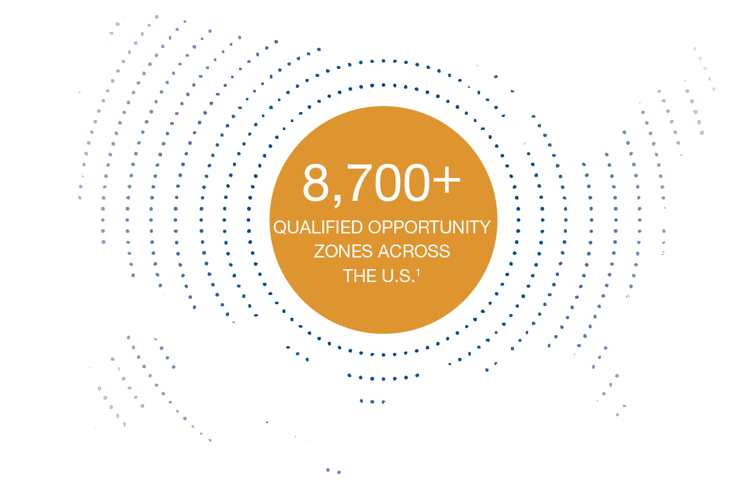
Market Opportunity
$6 TRILLION¹
Estimated unrealized capital gains from both U.S. households and corporations
1 MILLION²
Properties across all property types nationwide are believed to be located within Qualified Opportunity Zones
$49,900³
Average household income in Qualified Opportunity Zones
18.2%⁴
Total land area in the U.S. that is represented by Qualified Opportunity Zones; comprises 5.4% of major metro land area
¹ Economic Innovation Group, 2018.
² CoStar, 2019.
³ Economic Innovation Group, 2020.
⁴ ESRI, 2018.

Slide 13
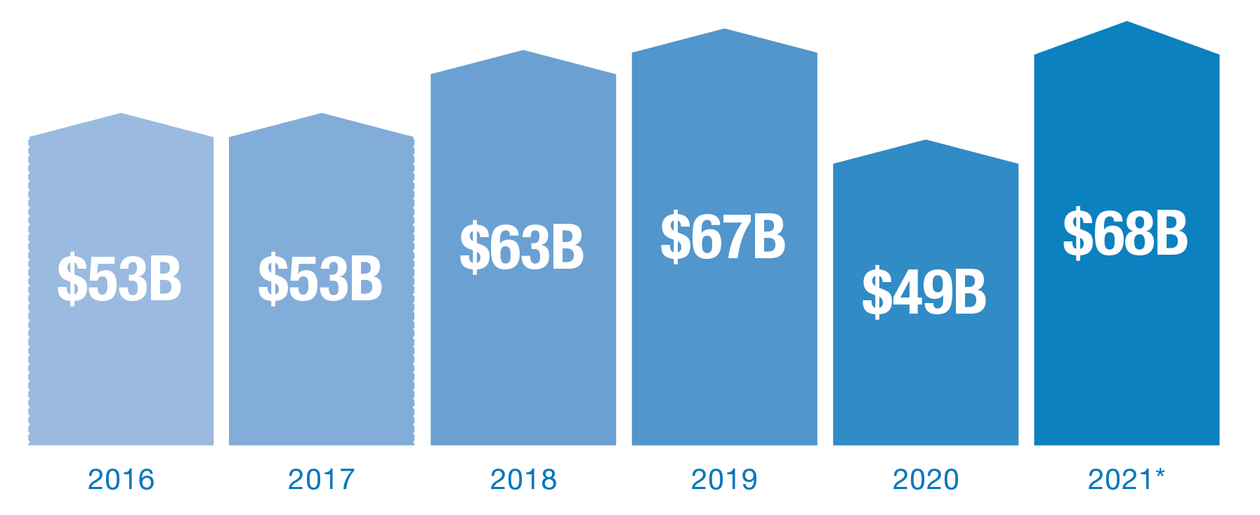
Capital Invested in Qualified Opportunity Zones
$353 BILLION*
Total investments in markets now deemed Qualified Opportunity Zones from 2016-2021
The volume of new real estate investment in QOZs has been robust, even before the QOZ Program was enacted. Over the period from 2016 to 2021, approximately $353 billion has been invested in markets designated as QOZs, an average of $59 billion per year.* In the two years preceding the creation of the QOZ Program, $106 billion, or $53 billion per year, was invested in QOZs, demonstrating that while QOZs are lower income communities, they are often attractive places to invest capital, regardless of the tax benefits associated with the QOZ Program. The additional tax benefits afforded under the QOZ Program should continue to drive additional investment in these areas, driving continued economic growth.
| U.S TOTAL SALES VOLUME¹
¹ Newmark Research.
* Investments in 2021 are 1Q-3Q 2021 Annualized.

Slide 14
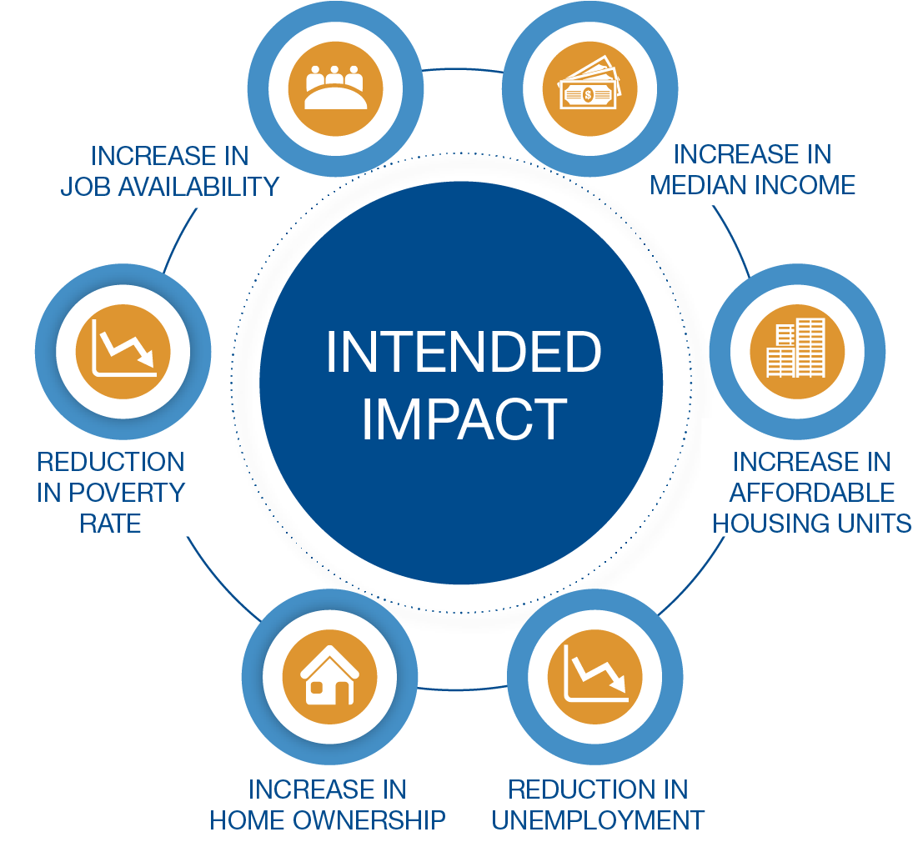
Intended Positive Impact of the QOZ Program
QOFs offer an attractive tax-advantaged investment solution that may be used as a force for positive social impact and economic growth.

Slide 15
Understanding Eligibility
2
WHAT IS AN
“ELIGIBLE” TAXPAYER?
WHAT IS AN
“ELIGIBLE” GAIN?
The proposed regulations provide that taxpayers eligible to elect gain deferral include:
Individuals
C Corporations (Including regulated investment companies (RICs) and real estate investment trusts (REITs)
Partnerships, and
Certain other pass-through entities
The first day of the 180-day period to reinvest gains into a QOF generally is the date on which the gain would be recognized for federal income tax purposes
Gain is eligible for deferral if it is from the sale or exchange of property with an unrelated party (not more than 20 percent common ownership) and the gain is treated as a capital gain (short-term and long term) for federal income tax purposes, including gains from:
Stocks, bonds, options, hedge funds
Primary and secondary residences
Businesses, machinery, commercial buildings
Land, livestock, art, wine, automobiles
See Prop. Treas. Reg. §1.1400Z-2(a)-1(b)(1).
See Prop. Treas. Reg. §1.1400Z-2(a)-1(b)(2)(iii).

Slide 16
Potential Tax Benefits
Substantial potential tax benefits may be available to investors who realize short-term or long-term capital gains from the sale of an investment and reinvest those gains into a QOF within 180 days. Gains from stocks, bonds, real estate, companies, among other assets, are eligible.
DEFERRAL
If a taxpayer invests the capital gain from the sale of any property into a QOF within 180 days of recognizing the gain, taxes on such proceeds may be deferred until the earlier of December 31, 2026¹ or the disposition of the QOF interest.
ELIMINATION
Investors who hold their investment for at least ten years receive a step-up in basis which means they pay no tax on the appreciation of their QOF investment upon disposition or through 2047, whichever occurs first, regardless of the size of the potential profit.² In addition, the step-up in basis eliminates any depreciation recapture tax that would otherwise be owed upon sale.
¹ A 10% step-up in basis was available for investments made prior to December 31, 2021 and an additional 5% step-up in basis was available for investments made prior to December 31, 2019.
² Assumes that the investor is a resident of a state that conforms with the QOZ Program or a no state income tax state, otherwise the investor will owe tax on any realized gain in investor’s state.

Slide 17
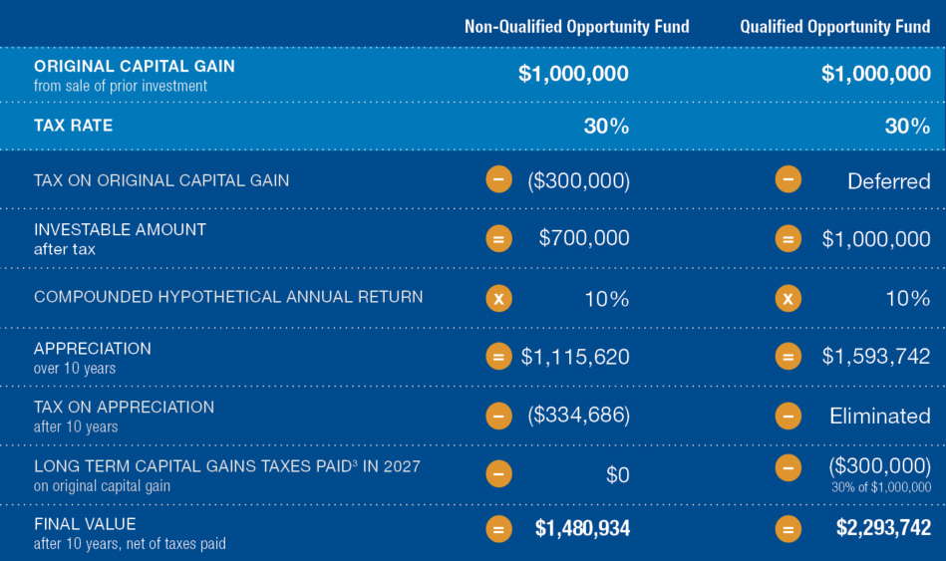
An Opportunity for Increased After-Tax Return Potential
SCENARIO: HYPOTHETICAL AFTER-TAX VALUE^{1,2,3}
Two investors each sell an asset that generates a $1,000,000 long-term gain. Investor A pays capital gains taxes and invests the remaining capital in a product that generates a 10% compounded annual return over ten years and then liquidates the investment. Investor B invests the gain in a Qualified Opportunity Fund, which generates the same return over the same time period. Both investors are residents of a state that conforms with the QOZ Program and are subject to the top marginal U.S. federal income tax rate of 20% on long-term capital gains for individuals, the net investment income tax of 3.8% and a state tax of 6.2%, for a total tax liability of 30%.
¹ This illustration assumes the investor is subject to the top marginal U.S. federal income tax rate of 20% on long-term capital gains for individuals, the net investment income tax of 3.8% and a state tax of 6.2% for a total tax liability of 30%. No brokerage or investment advisory fees are accounted for with respect to the non-QOF example above and no distributions made on the Class C common stock, no fees due to our Manager and its affiliates and no sales commissions, deal manager fees and non-accountable diligence and marketing allowances due to our Managing Broker-Dealer and its affiliates are accounted for with respect to the QOF example.
² This assumes that the QOF investor is a resident of a state that conforms with the QOZ Program.
³ Assumes that the investor has no capital losses to reduce such capital gain and refers to the inclusion of the original, invested capital gains in such investor’s taxable income on December 31, 2026.

Slide 18
Quantifying the Tax Benefits
¹This illustration assumes the investor is subject to the top marginal U.S. federal income tax rate of 20% on long-term capital gains for individuals, the net investment income tax of 3.8% and a state tax of 6.2% for a total tax liability of 30%. No brokerage or investment advisory fees are accounted for with respect to the non-QOF example above and no distributions made on the Class C common stock, no fees due to our Manager and its affiliates and no sales commissions, deal manager fees and non-accountable diligence and marketing allowances due to our Managing Broker-Dealer and its affiliates are accounted for with respect to the QOF example.
² This assumes that the QOF investor is a resident of a state that conforms with the QOZ Program.
³ Assumes that the investor has no capital losses to reduce such capital gain and refers to the inclusion of the original, invested capital gains in such investor’s taxable income on December 31, 2026.

Slide 19
A Comparison of 1031 Exchanges and QOFs
1031 Exchange
Category
Eligible Assets*
Rollover parameters
Eligible investments
replacement property
Capital gains tax
Investment goals
Qualified Opportunity Fund
Real estate held for investment purposes.
Any investment including stocks, bonds, real estate, collectables, partnership interests, etc.
Principal and capital gains of the real estate sale.
Capital gains only (principal not required).
Real property without location restrictions.
Generally includes commercial real estate, housing, infrastructure and businesses within an OZ.
Must identify a replacement property within 45 days and close within 180 days.
No identification requirement. The gain must be invested in a QOF within 180 days.
May be deferred indefinitely with a step-up in basis upon death.
The original gain may be deferred but must be included in income on December 31, 2026. Any new gain may be eliminated as well as any depreciation recapture tax that would otherwise be owed upon sale.
Maximize after-tax return through income and appreciation.
Maximize after-tax return through income and appreciation.
*Gains recognized from the disposition of the following assets are eligible to receive the respective tax benefits of the 1031 exchanges and investments in QOFs.

Slide 20
PLANNING AND EDUCATION
^{RESOURCES}

Slide 21
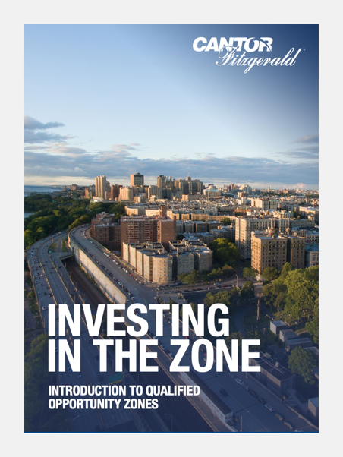
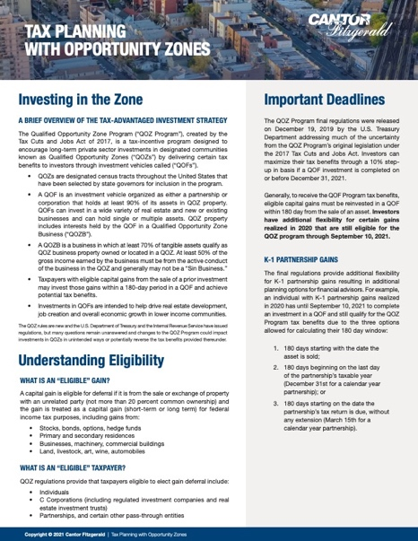
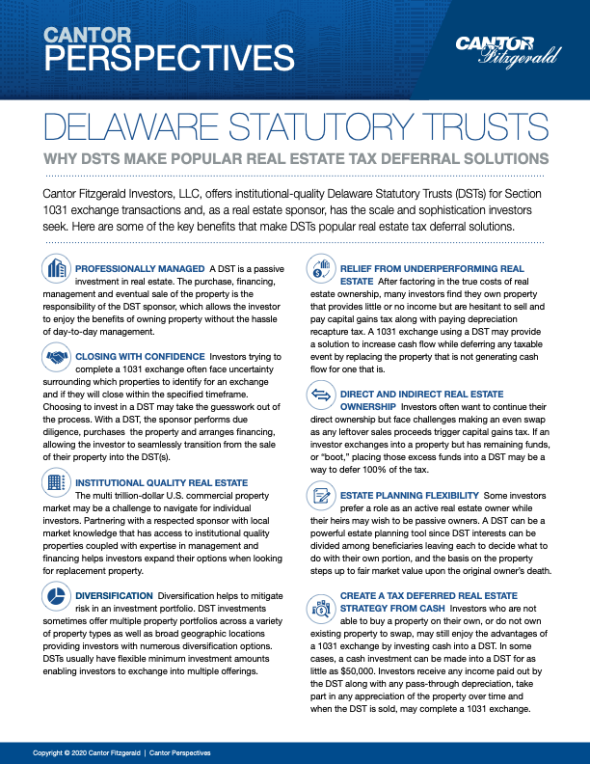
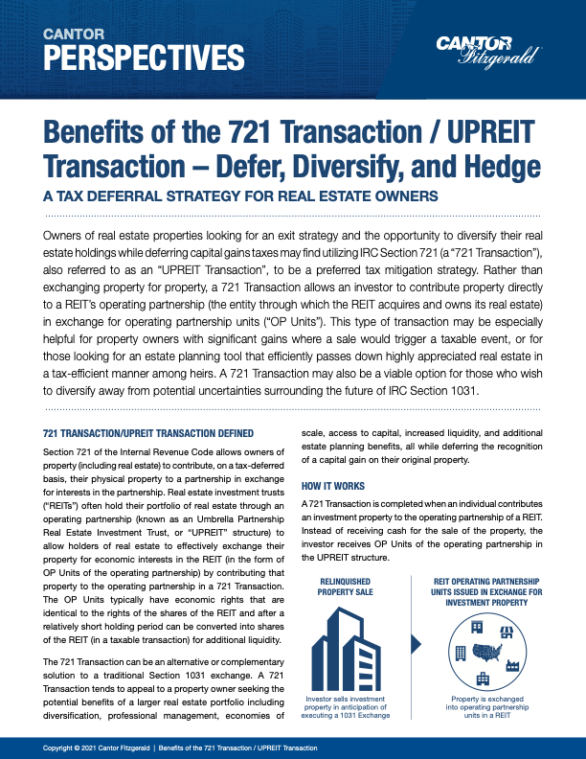
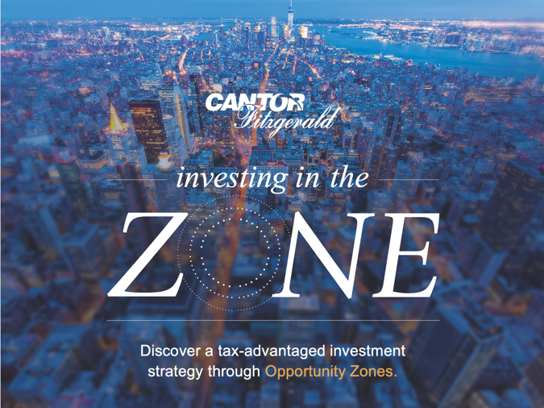
Educational Resources (CFP, CPA, and CLE CE Eligible)

Slide 22
Final Regulations and K-1 Partnership Gains
The Treasury Department published the final set of Opportunity Zone regulations on December 19, 2019. These regulations build upon two prior sets, released in October 2018 and April 2019, respectively.
The final regulations provide additional flexibility for K-1 partnership gains resulting in additional planning options for financial advisors. For example, an individual with K-1 partnership gains realized in 2021 has until September 11, 2022 to complete an investment in a QOF and still qualify for the QOZ Program tax benefits due to the three options allowed for calculating their 180-day window:
180-days starting with the date the asset is sold;
180-days beginning on the last day of the partnership’s taxable year (December 31st for a calendar year partnership)
180-days starting on the date the partnership’s tax return is due, without any extension (March 15th for a calendar year partnership)

Slide 23
Irrevocable Grantor Trusts
Irrevocable Grantor Trusts (IGTs)
Strengths
Legally remove assets from donor’s estate
Enables families to pass assets from generation to generation
Protection from unforeseen lawsuits, estate taxes, medical expenses, etc.
Highly effective in shielding both the trust’s grantor and its beneficiaries from claims on assets
Weakness
Assets held in an IGT are not eligible for the step-up in basis because they are no longer considered part of the estate leaving beneficiaries with the possibility of having a low-cost basis and the potentially large capital gain liability that comes with it
Qualified Opportunity Funds (QOFs)
Potential Solution
Elimination of new capital gains through a step-up in basis if held for 10+ years
Deferred tax can be paid by IGT assets for the grantor’s assets, reducing the taxable estate
Final OZ Regulations clarified that a gift to an IGT would not be an inclusion event of the deferred gain. In other words, it is a nonevent for tax purposes, and the OZ benefits would remain in place. In addition, the guidance specifies that upon the grantor’s death that the benefits of the QOF investment would remain intact for the beneficiary, including the donor’s holding period.
Action Steps
Identify clients with large estates and significant capital gains
Educate CPA and Estate Planning Attorneys

Slide 24
Planning Concepts – Next Steps
Become an expert on OZs, DSTs and 721s
Realized short and/or long-term gains within the last 180 days
Unrealized short and/or long-term capital gains
Concentrated stock positions
Portfolio rebalancing
Real estate held for investment purposes sold Jan 1, 2021, or later
K-1 gains realized Jan 1, 2021, or later
Large and complex estate planning needs
Primary and secondary home gains realized within the last 180 days
Art and other collectibles sold over the last 180 days

Slide 25
Cantor Fitzgerald & Co.
110 E. 59th St.
New York, NY 10022
1-855-9-CANTOR
cfsupport@cantor.com
www.cantor.com

